Slide 1
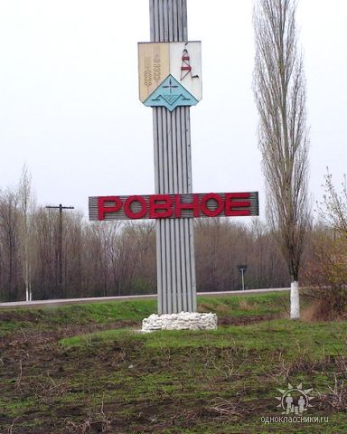
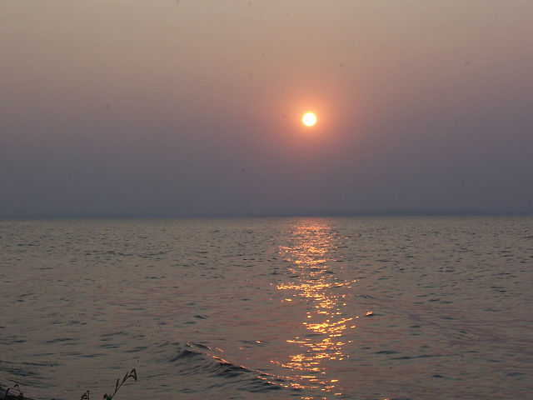
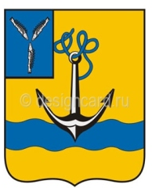
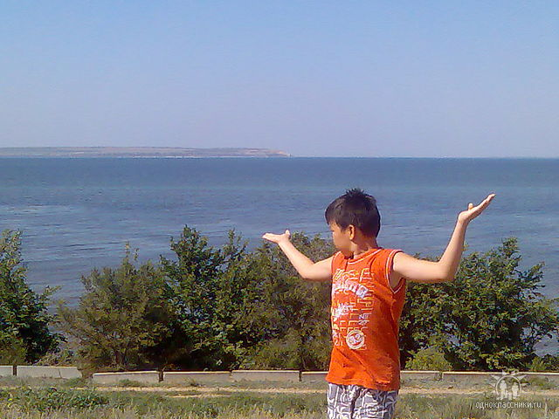
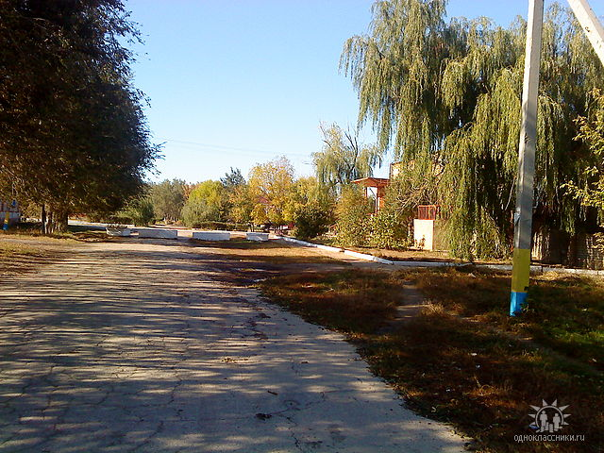
WELCOME TO ROVNOE!

Slide 2
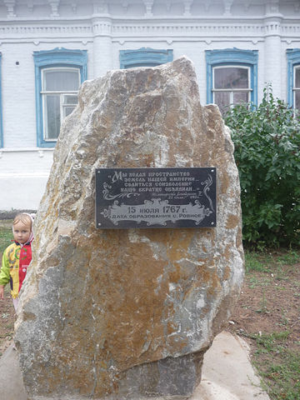
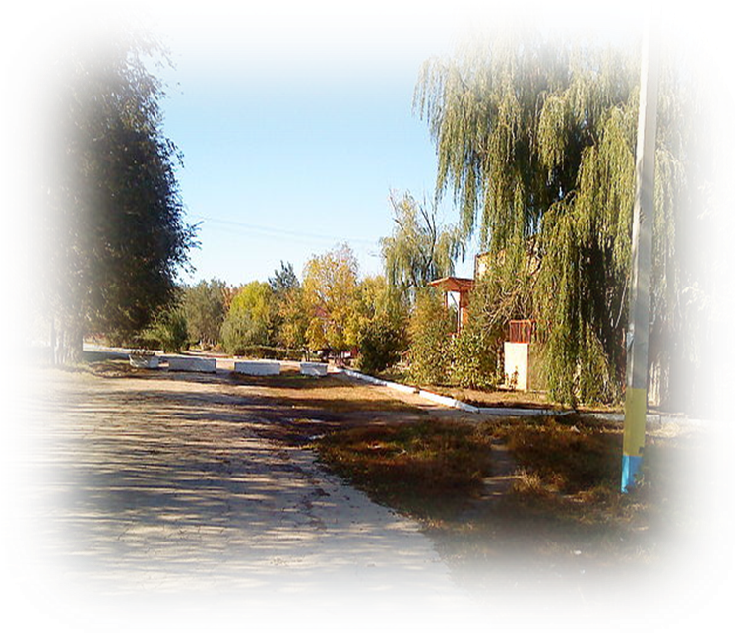
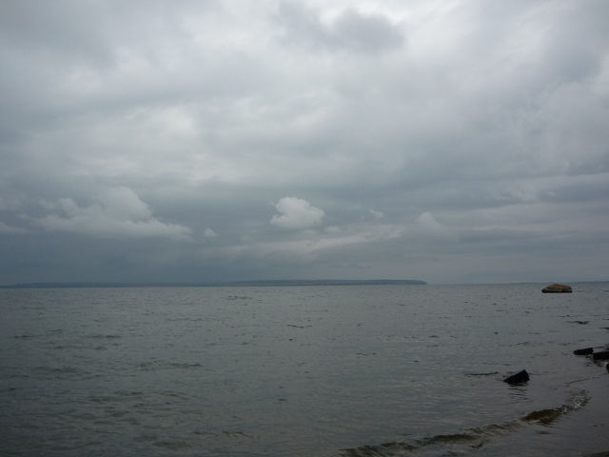
My homeplace Rovnoe is a picturesque town situated on the left bank of the Volga in a hundred kilometers from the city of Saratov. Its history dates back to the 18th century, when the German colonists being invited by the Empress Catherine the Great arrived in Russia to settle in the lower Volga river. They founded the settlement of Zeelman (Rovnoe) in 1767 and it had this name till 1941. Now the population of Rovnoe is about 5,500 people.
It is a center of the Rovnoe municipal district.

Slide 3
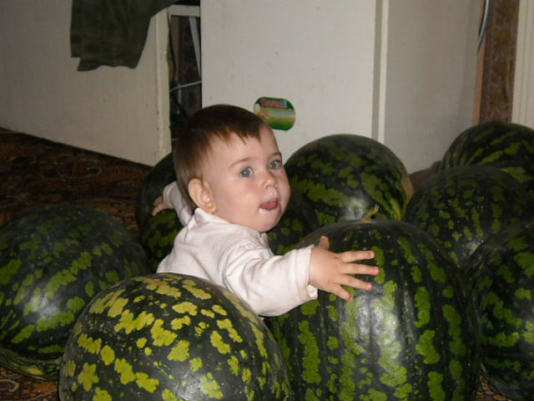
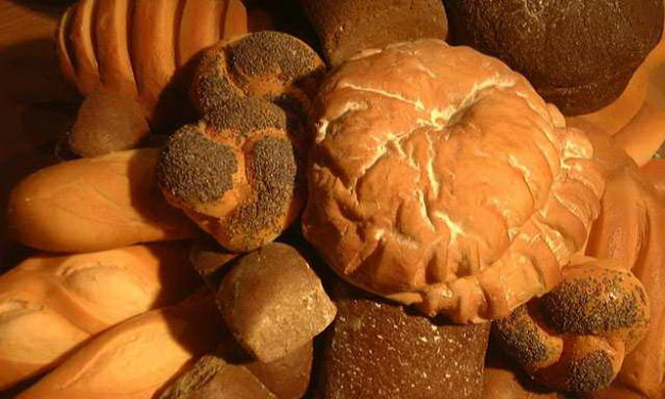
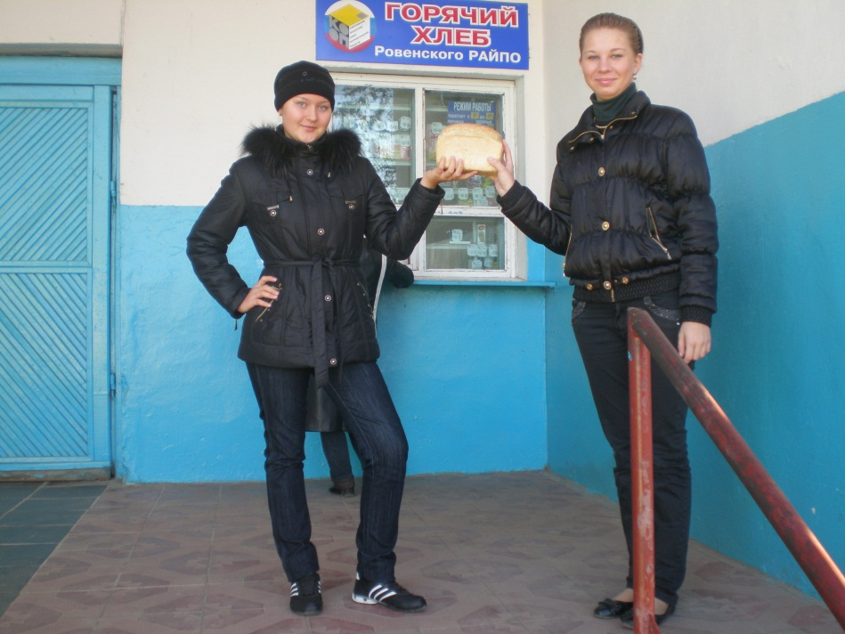
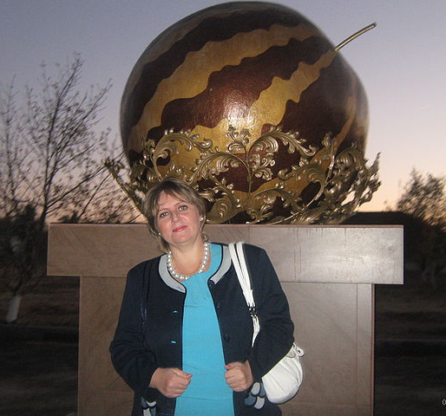
Rovnoe has favourable climatic conditions for farming and plant growing. Summers here are a bit warmer than in northern areas of the Saratov region. Our farmers can even grow melons and watermelons in their fields. It’s not occasionally that a watermelon became the symbol of the district and we have a monument to it next to the central square of Rovnoe. Rovnoe’s bread is also well-known far off the district as very puffy and tasty.

Slide 4
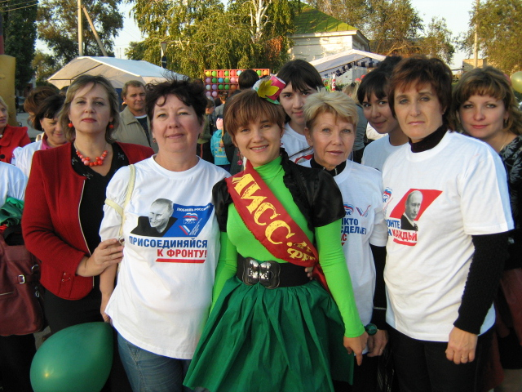
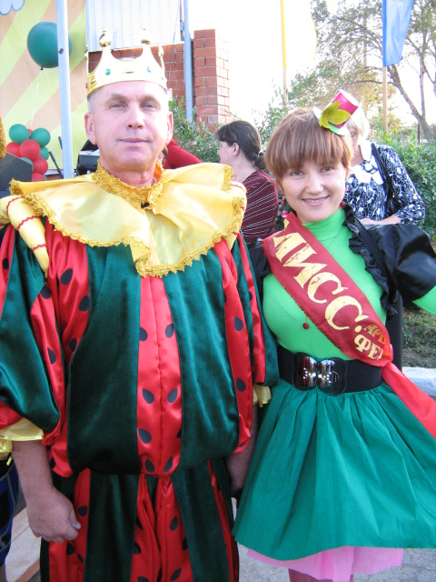
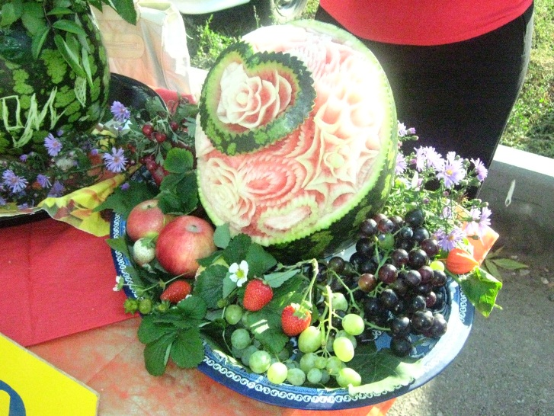
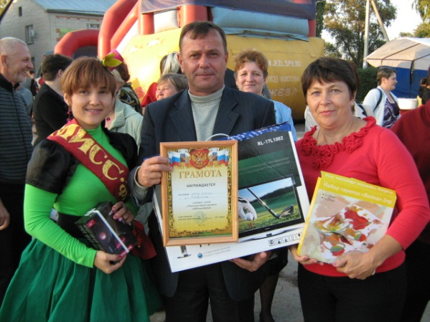
One of the main events held on the Day of Rovnoe in 2011 was a carnival called “Water-melon extravaganza ”. Our school won the first prizes in all the nominations of the festival.

Slide 5
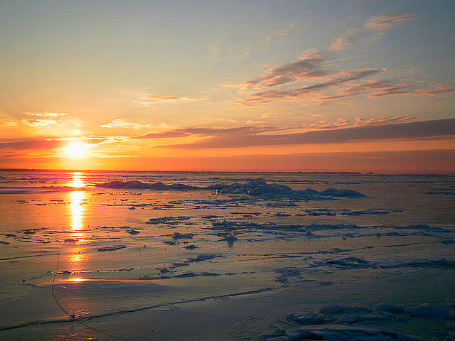
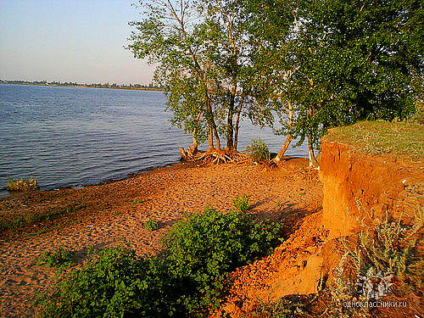
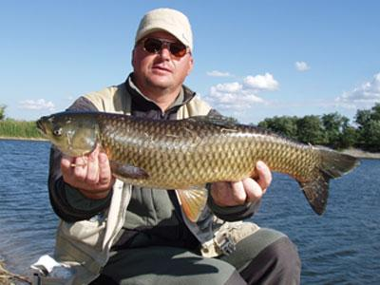
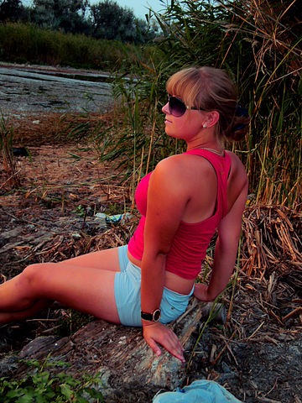
The special pride with Rovnoe dwellers is our great river, the Volga. You can spend unforgettable summer holidays here enjoying nature, fine weather, fishing, swimming and sunbathing.

Slide 6
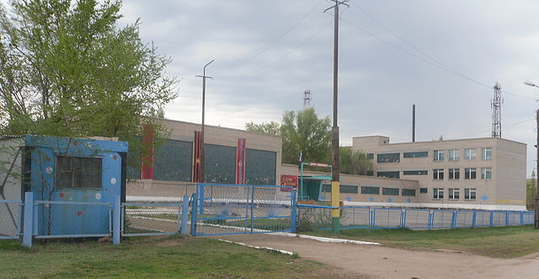
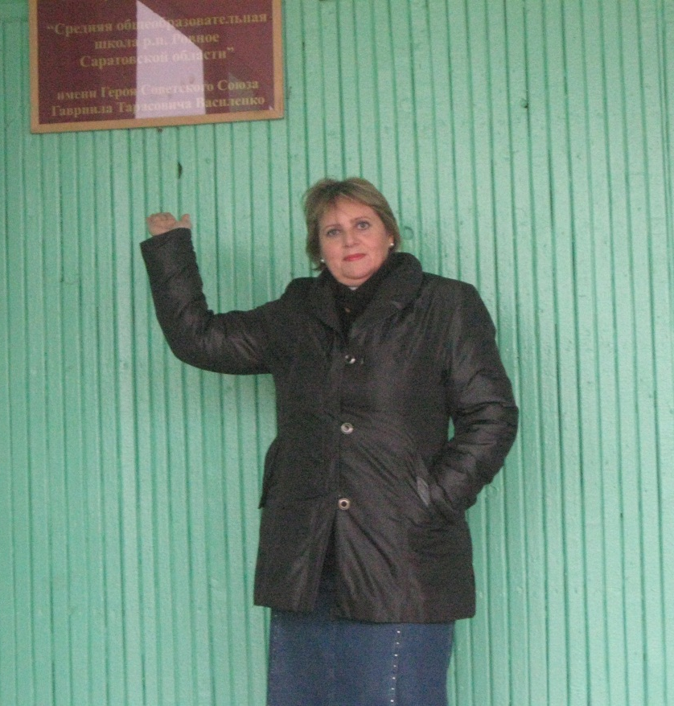
The school I work at is a secondary comprehensive school. Children at the age of 6-18 learn here.
Our school is named after the Hero of the Soviet
Union Gavriil Tarasovich Vasilenko. In September
1942 he formed in Rovnoe the Second flexible
airbone brigade to defend our Motherland from
Nazi invaders during the Great Patriotic War
(1941-1945).

Slide 7
In the school hall we have a memorable corner with the information about T. G. Vasilenko’s life and deeds. On the 15th of September we celebrate the Day of our school.

Slide 8
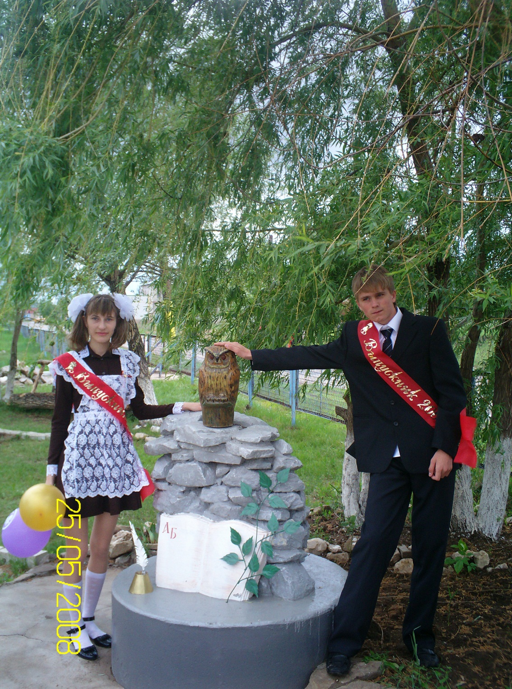
Have a look at this monument
made by the hands of our pupils!
It shows the main aim why they go to school. Have you guessed what it is?
It’s a symbol of knowledge. You have to climb up a high rocky mountain of knowledge to get wisdom.
At the bottom of knowledge there is your first ABC book. Our school-leavers are fond of taking pictures at this place.

Slide 9
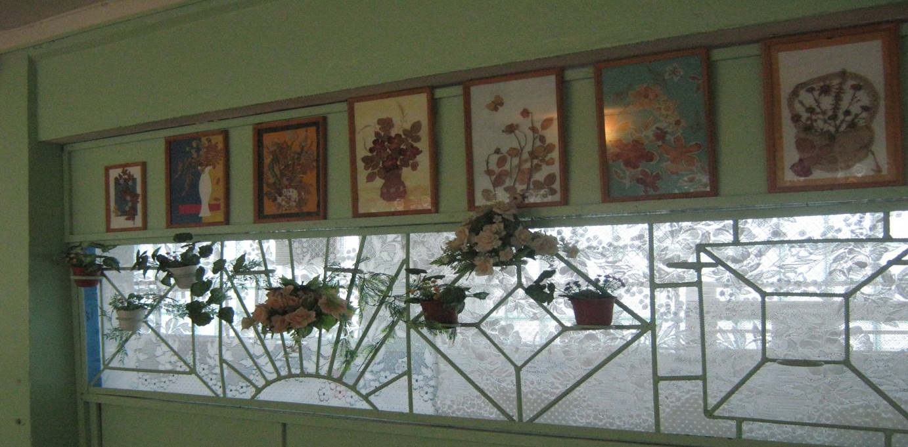
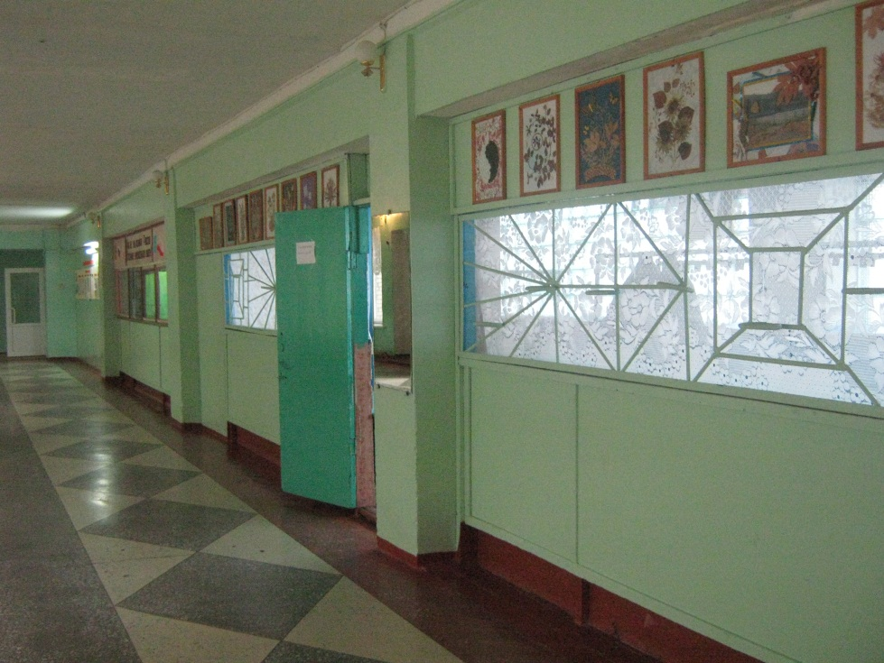
Let’s walk along the spacious school corridors where you can see the exhibitions of schoolchildren’s pictures and works.

Slide 10
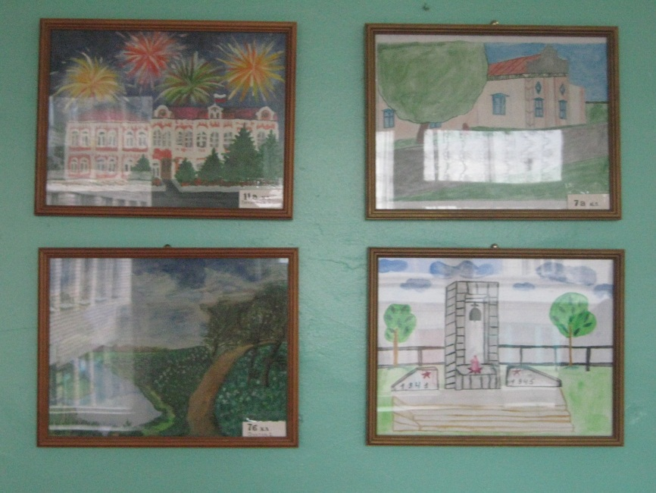
One of the expositions is dedicated to the
native settlement and called by the
line from the verses written by our former
principal, a local poet N. Pyakhin “For us
our Rovnoe is lesser Russia, it’s Russia
sweet, inimitable one”.

Slide 11
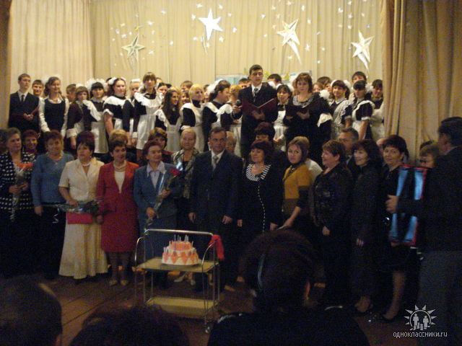
Our students and teachers make up one friendly creative team.
This is the way we celebrated the 25th anniversary of our school in 2008.

Slide 12
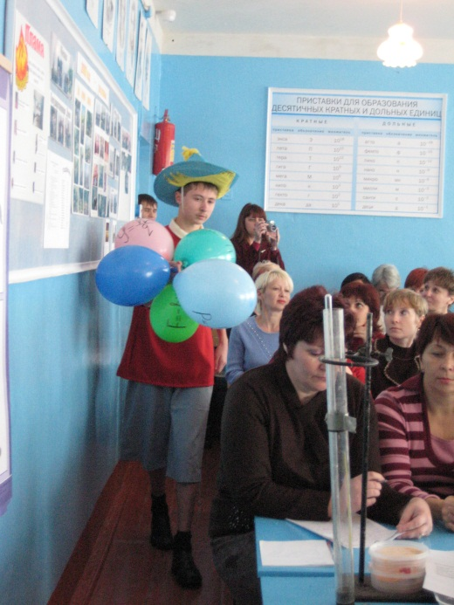
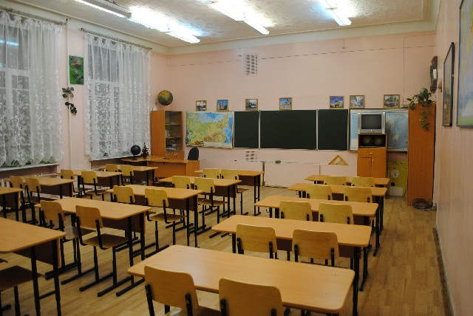
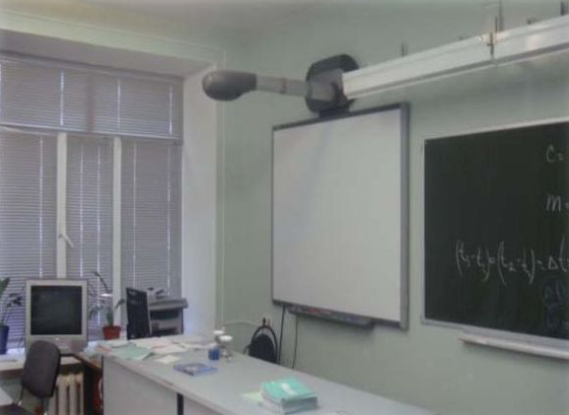
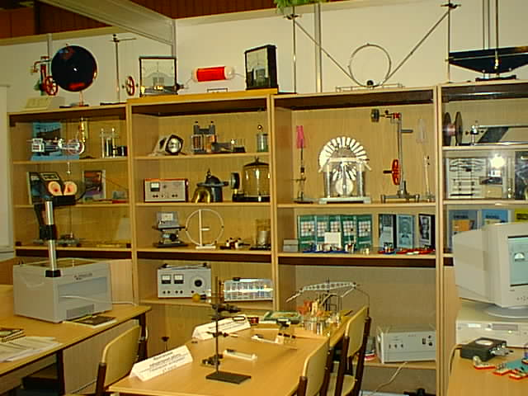
Our school is proud of pupils’ success. Last year 5 school-leavers finished school with gold medals, now they are students of the prestigious Saratov’s institutes. Great changes have been taking place in the Russian system of education for the last few years. New equipment (including computers and whiteboards) and school furniture are being distributed to schools within the frames of all-Russian priority national project “The development of education”. Our school has got new equipment for the rooms of chemistry, physics, biology and mathematics.
The pupils organized the opening ceremony of physics room for the
teachers of physics of the Rovnoe district.

Slide 13
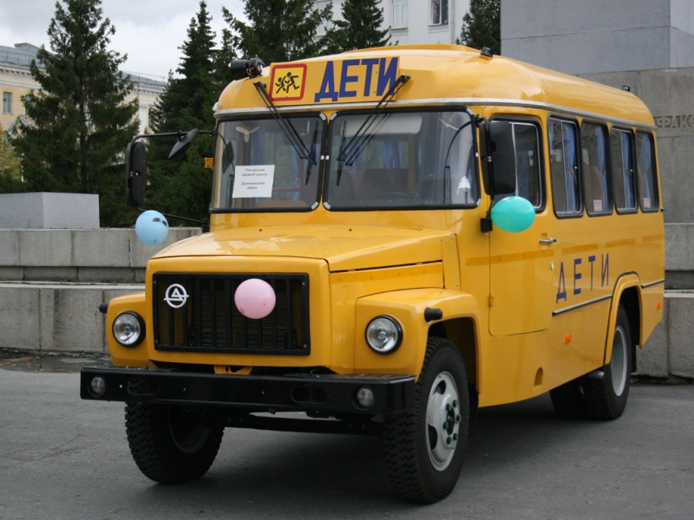
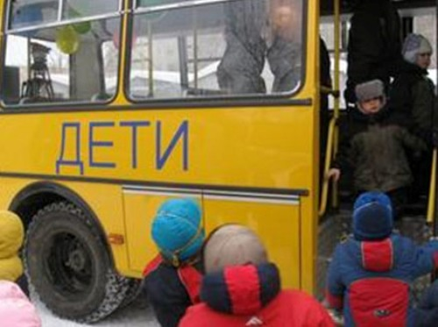
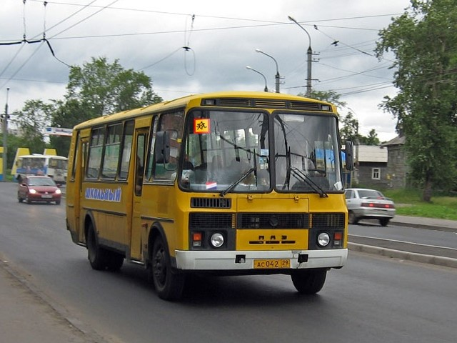
In 2008 our school got a new bus, now we have two school buses which take pupils studying at school to the nearby villages of Beregovoe and Privolnoe where they live. The buses take schoolchildren to various excursions, sport and other kinds of competitions.

Slide 14
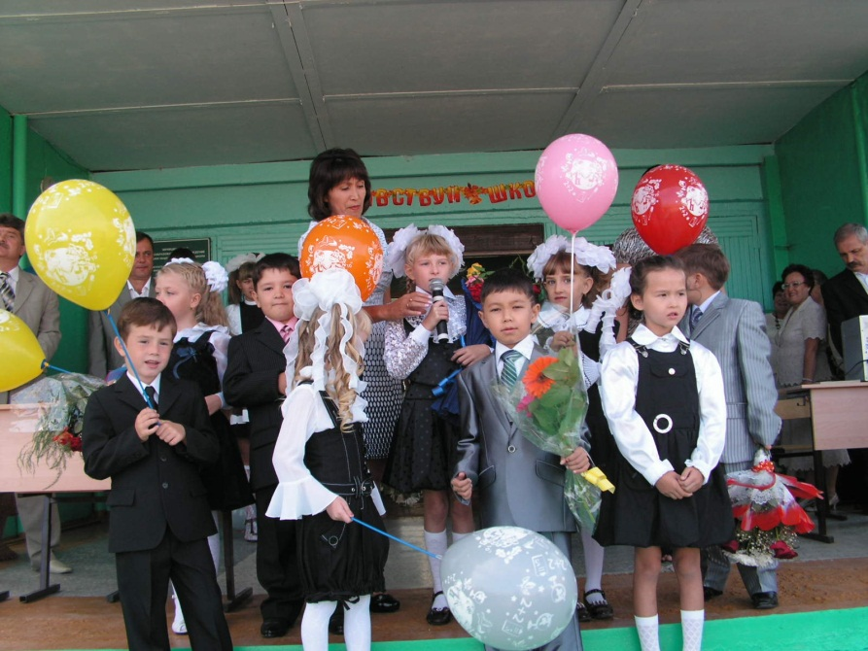
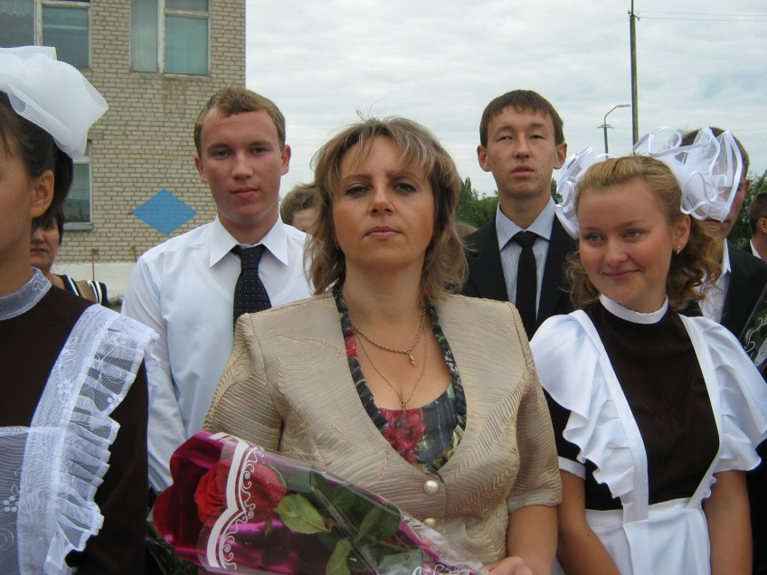
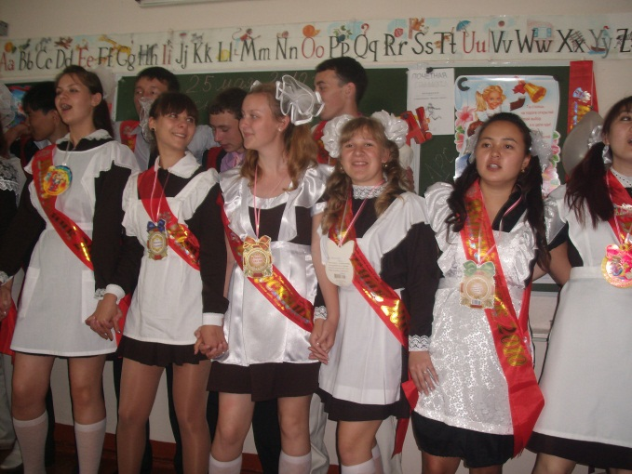
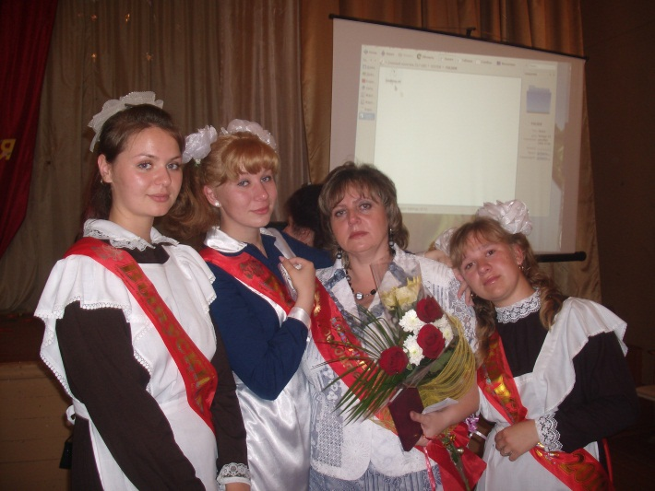
The classic of Russian education A.S. Makarenko once said that a collective is strong if it has strong traditions. Of course there are some traditions at our school.
These are the holidays of the First and the Last Bell. 2 years ago I was a class teacher of the 11th grade and said good bye to my school leavers. It was a very touching event and we couldn’t help crying.
On the 1st of September
and on the 25th of May 11th
graders wear traditional parade
uniform which reminds the
uniform their parents used to
wear when they learnt at school

Slide 15
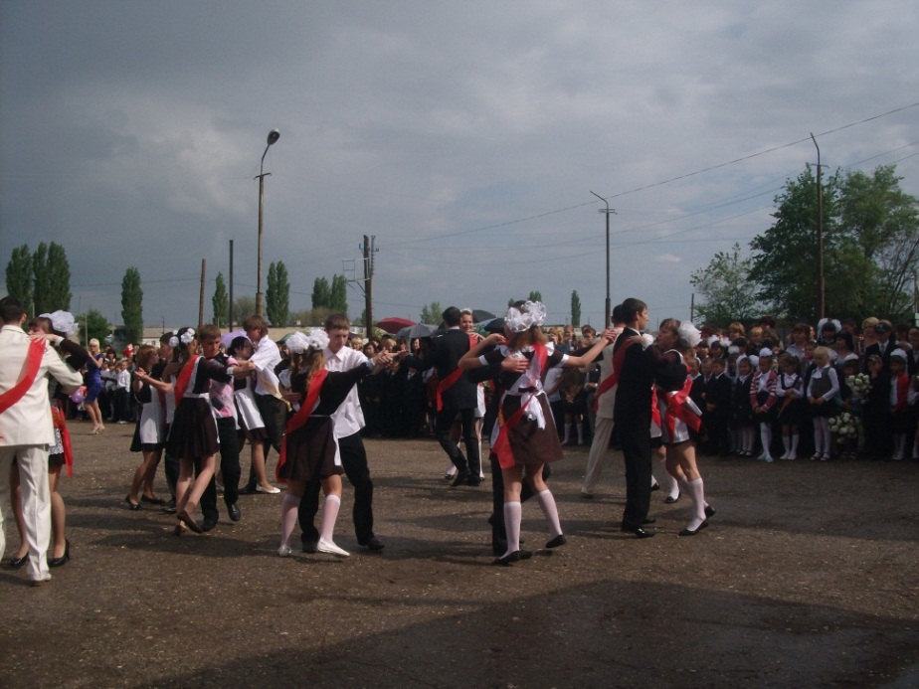
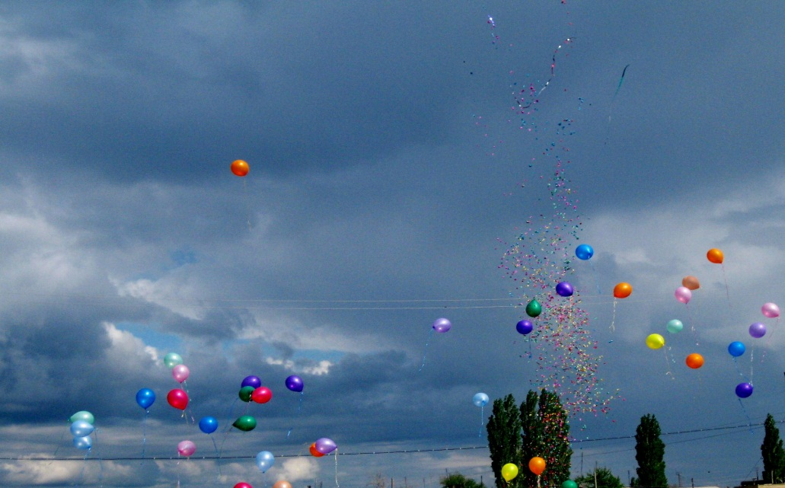
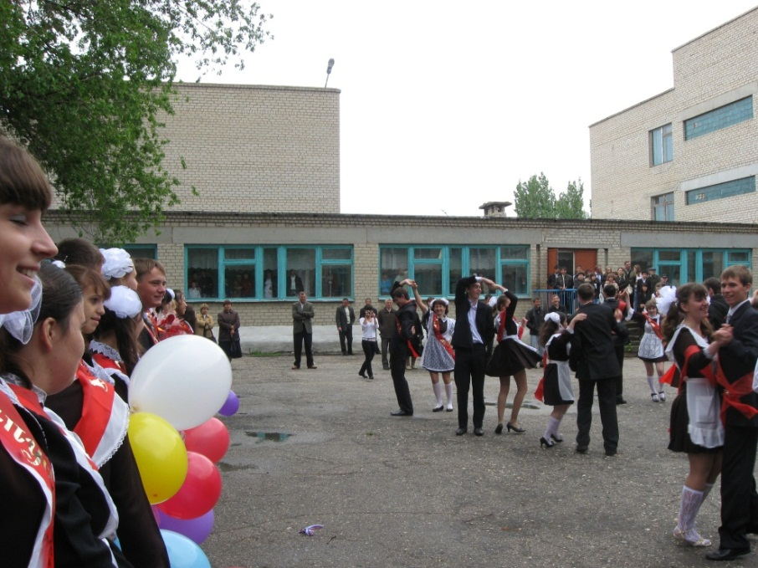
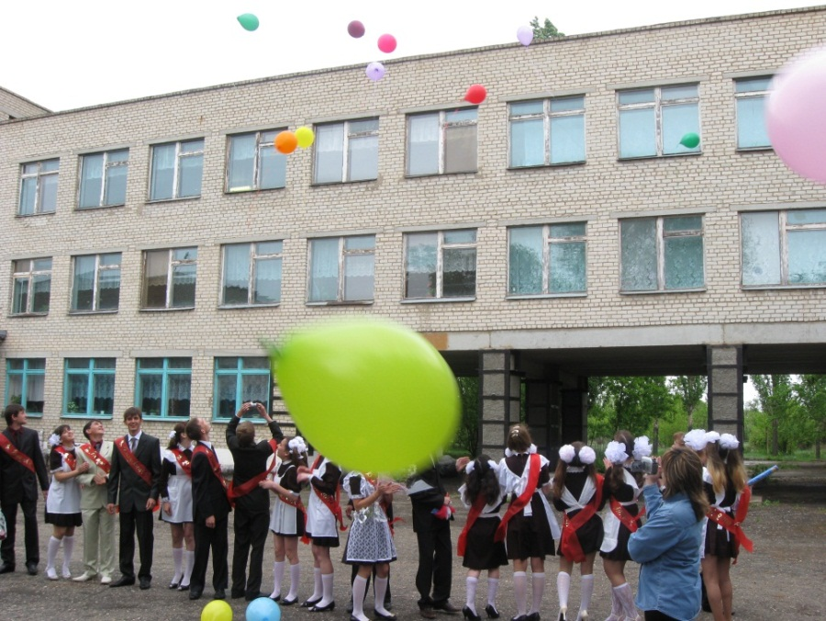
The school leavers dance their farewell waltz in the schoolyard and launch colorful balloons into the May sky.

Slide 16
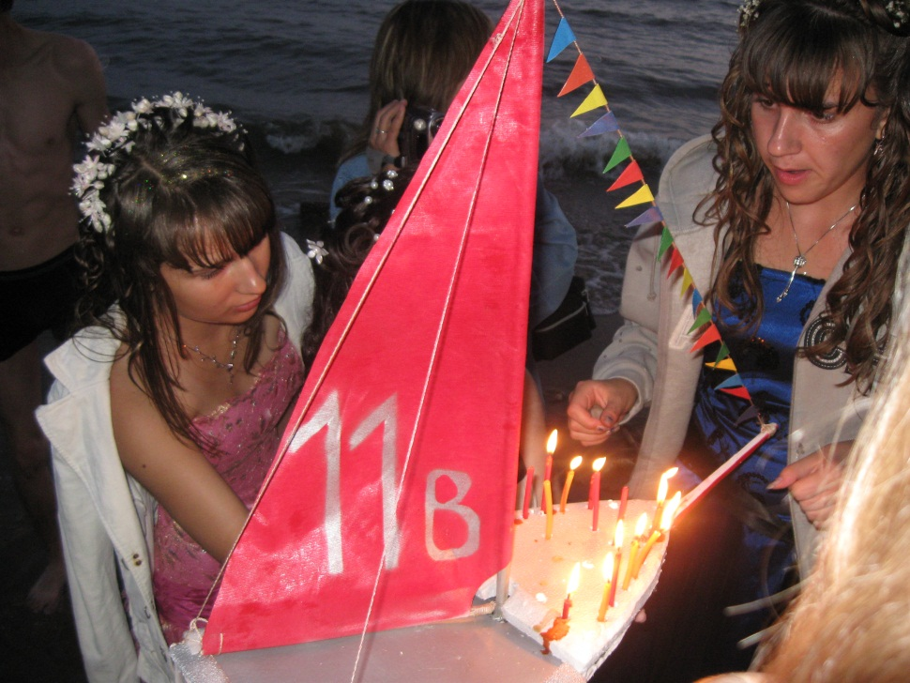
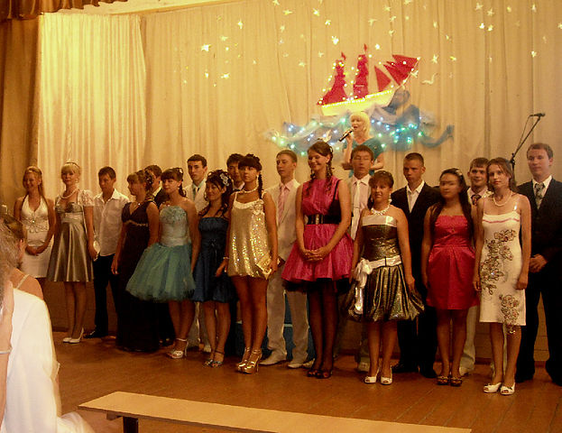
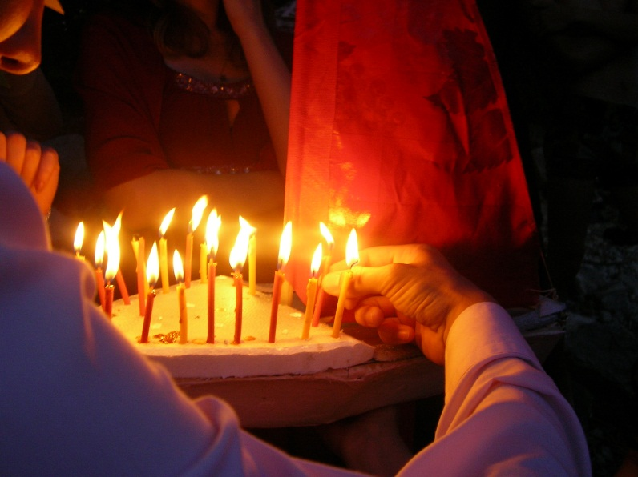
The symbol of our school youth organization “Iskateli”(Searchers ) is a brigantine with scarlet sails which stands for youth hopes, aspiration for the better. That’s why at a school leaving party the school leavers make a model of a brigantine, put it into the river and let it drift with the current at the first dawn of their after school adult life.

Slide 17
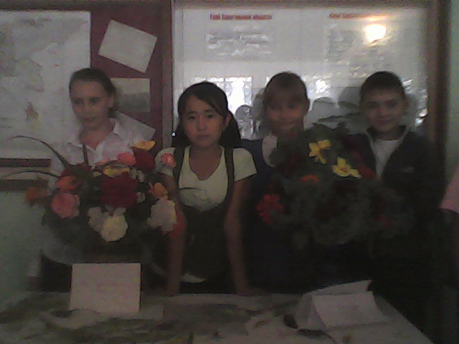
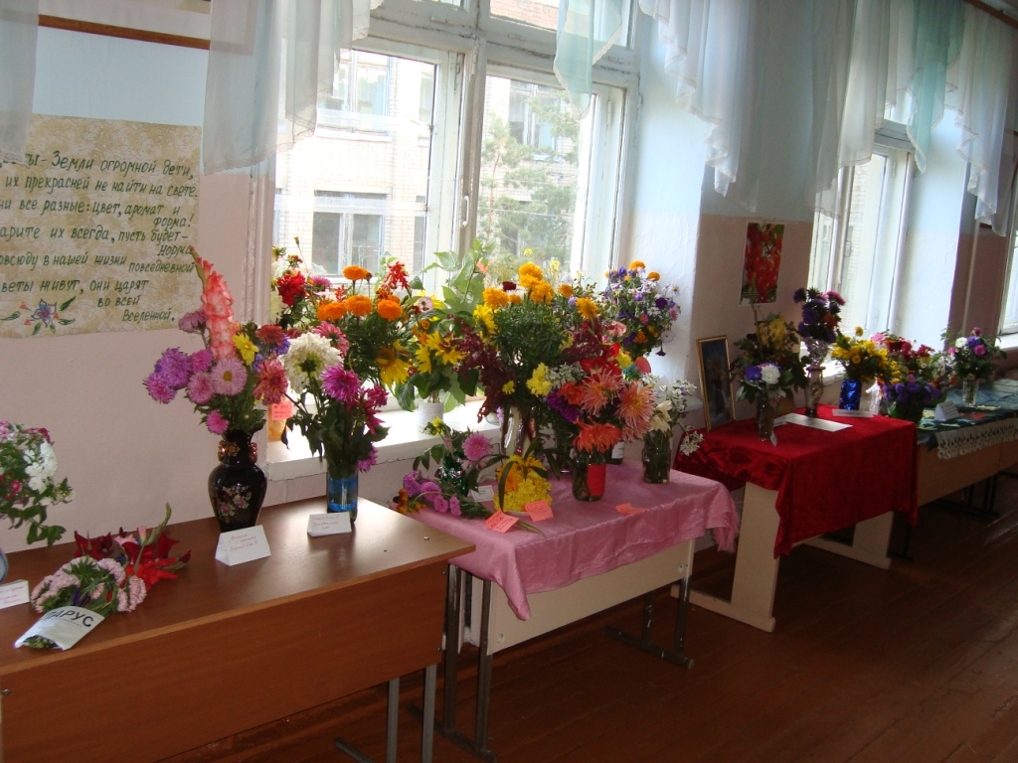
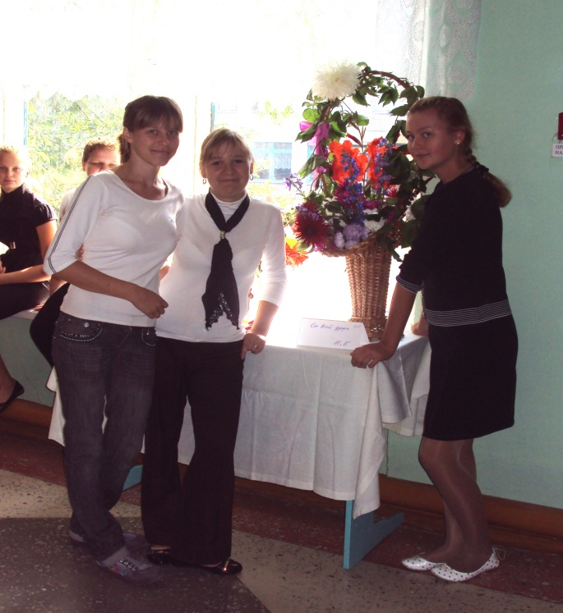
Early autumn is the most beautiful time in Rovnoe when the gardens smell sweet with flowers. So the school holds an annual competition for the best flower bouquet or flower composition. At the photos you can see my former 11th graders and
present-day students.

Slide 18
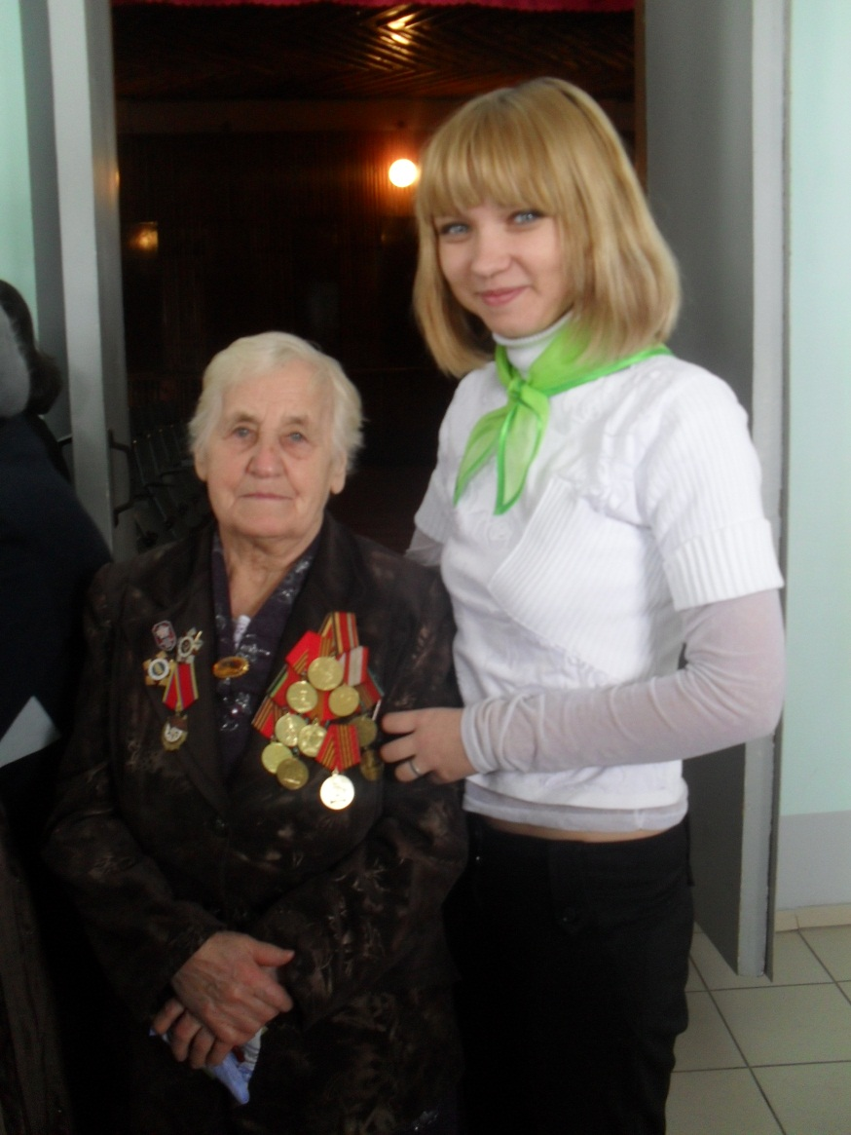
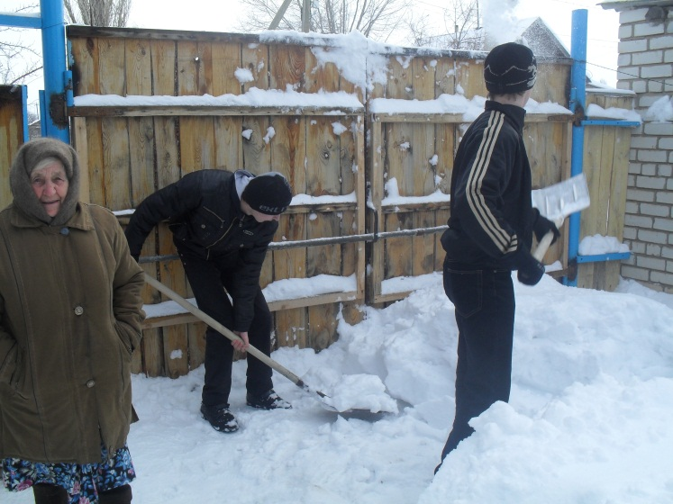
We teach our pupils to remember the history of Russia, to respect and help World War veterans as they are rather elderly now and need our care and sympathy. We organize school and class meetings with them, where the children listen to the stories about the terrible days of the Great Patriotic War, their battles and hardships of war and postwar life.
We organize school charity actions to help our veterans and elderly people at their homes.

Slide 19
On the Victory Day, May 9, our pupils take an active part in the municipal “Memory guard”. They stand at the Eternal Fire in the guard of honour, carry the flags of Russia and the Saratov region, congratulate veterans to the Victory Day, participate in concerts and so on.

Slide 20
Another exciting tradition is to participate in the annual theatrical festival of schools of the Rovnoe district. Our school always wins.
The performance “Gagarin’s stars”
Actors of the performance
“The miserly knight” by A. Pushkin
We stage pieces by the classics of Russian literature (A.Pushkin, V.Lermontov, V.Mayakovsky) and write our own versions. But the great thing is that we do it together with pupils.

Slide 21
Several times I performed in such plays too. It was a great experience, especially when our audience were the war veterans, as we decided to dedicate the performance to the memory of soldiers fallen in the battles of the Great Patriotic war.
At this photo you can see me and a senior pupil playing the parts of two Memories: Black and White ones.
I’m playing the role of Motherland in the performance “Russia’s Wreath” dedicated to great Russian personalities.
“The bedbug” by Mayakovsky

Slide 22
One of the main educational aims is to prepare our pupils for independent adult life. That’s why it’s very important to show them how their parents and grown-up people work at different branches of economy.
For this purpose school organizes different trips to the local and regional enterprises and pupils meet with people working there.
At picture3 you can see our pupils on the excursion round Balakovo atomic power station.

Slide 23
Sometimes our pupils have an excellent opportunity to try themselves in the roles of leaders at school and even in the whole district. I mean so called “Days of self-government”
Judging by the responses by the citizens and their
curators they cope with all uneasy tasks.

Slide 24
There are a lot of extracurricula activities at our school. One of the most popular clubs for children is a club of decorative and applied arts. Its talented leader T. Mitchenko and her students make real wonders. Just have a look!

Slide 25
As you have probably noticed the work of the school is divided into several directions: charity, patriotic education, handicraft, tourism, sport. The last one plays a very important part in pupils’ lives. There are football, basketball, volleyball, gymnastics, boxing, track-and-field clubs at school. Our pupils can train not only in the school gym but in the sport complex which has been recently opened in Rovnoe. It was built by the project of the political party “Yedìnaya Rossìya” (“United Russia”). The pupils take part in all sport events held at the district and go to different competitions in the cities of the Saratov region and Russia.
Our sport cups
Sport complex “Start” in Rovnoe

Slide 26
Two teams: Teachers and Pupils
My sixth graders are at school competitions
Sport is fun!

Slide 27
It’s always great to travel. Every year we take trips to different places. We took a tour round the Golden Ring of Russia(the ancient Russian cities of Sergiyev Posad, Pereslavl-Zalesskiy, Rostov Velikiy, Yaroslavl, Suzdal, Uglich and others). I with my pupils visited M. Lermontov’s family estate in Tarkhany, A.Pushkin’s residence in Boldino, the hero-city of Volgograd. The pupils of our school went to St.Petersburg and Moscow. Two years running the pupils of our school win the first place in a prestigious annual competition “The best pupil’s grade”. The main prize of it is a trip to Moscow including a visit to the State Duma. My own son was among them too.

Slide 30
Being a form teacher I try to make the life of my pupils more interesting and various. It’s important to foster in them tolerance, good manners, beauty, love for Motherland and nature, respect and care for the elderly and younger ones.
A New Year’s performance for the youngers
The New Year’s party
A merry relay race
A New year performance for the small children
The girls’ band from 11B
We are staging Gogol’s “The Inspector General” at the district library
On a picnic

Slide 31
We’re helping to make a skating-rink for children
The intellectual tournament
A visit to the hothouse
My basketball players
The day of tolerance
The international women’s day
We’re opening new talents
Mother’s Day

